Slide 1
Periodic Recurrence Relations and Reflection Groups
JG, October 2009

Slide 2
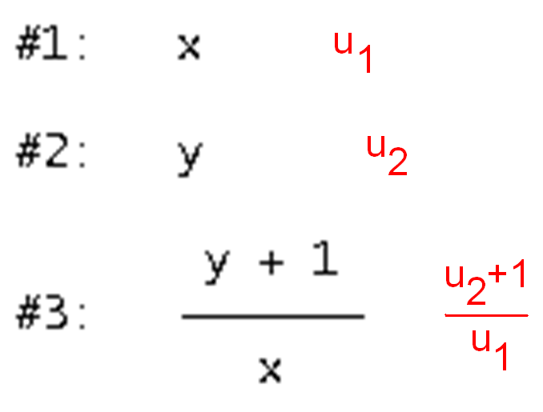

Slide 3



Slide 4
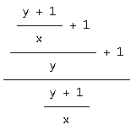


Slide 5


Slide 6

(R. C. Lyness, once mathematics teacher at
Bristol Grammar School.)
A periodic recurrence relation
with period 5.
A Lyness sequence: a ‘cycle’.

Slide 7
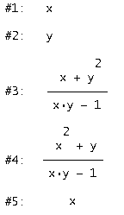


Period Three:
Period Two:
x
Period Four:
Period Six:

Slide 8
If we insist on integer coefficients…
Period Seven and over: nothing
Why should this be?

Slide 9
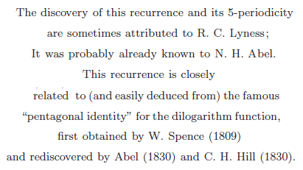
Fomin and Reading

Slide 10
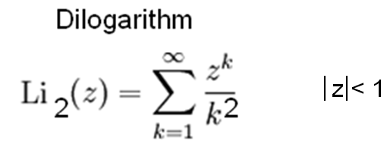


Slide 11
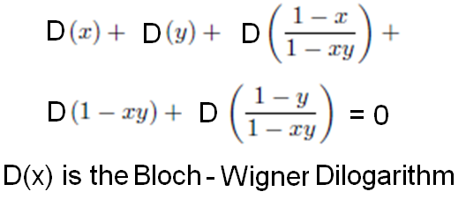
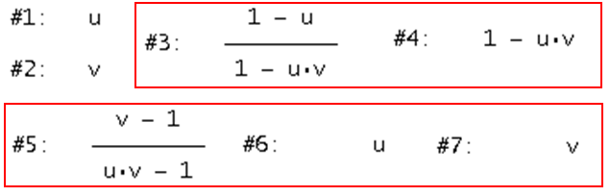

Slide 12
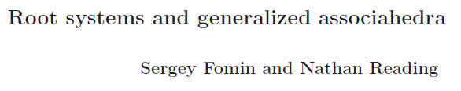
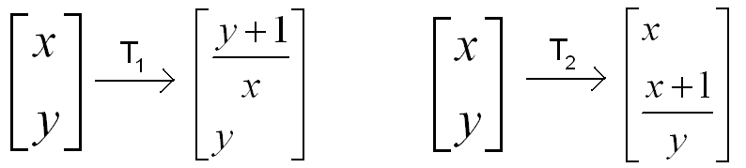
Note: T₁ is an involution, as is T₂.
What happens if we apply these involutions alternately?

Slide 13
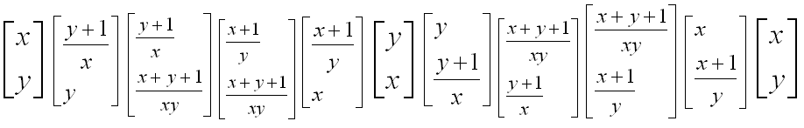
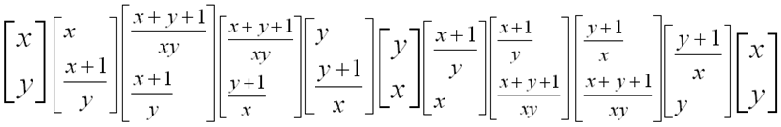
So T₁² = I, T₂² = I, and (T₂T₁)⁵ = I
Note: (T₁T₂)⁵ = I
But T₁T₂ ≠ T₂T₁
Suggests we view T₁ and T₂ as reflections.

Slide 14
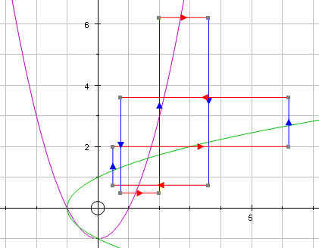

Slide 15
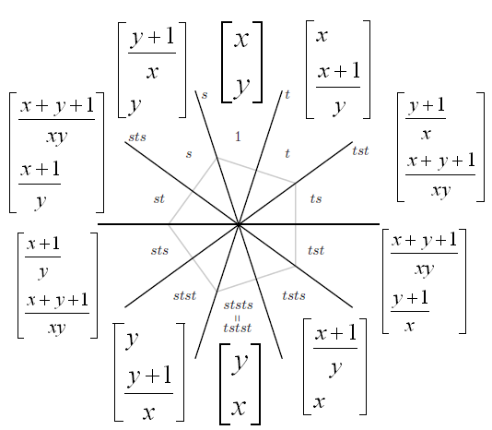

Slide 16
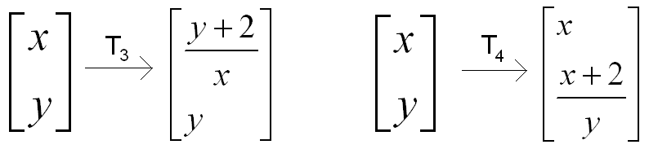
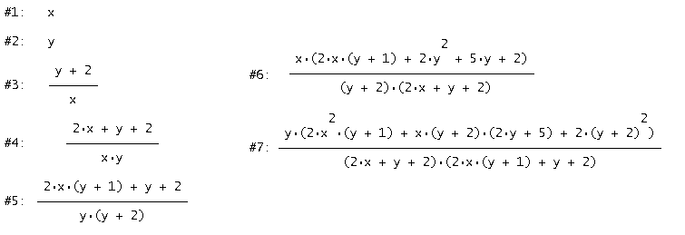
Conjecture: any involution treated this way as a pair creates a cycle.
Counter-example:

Slide 17
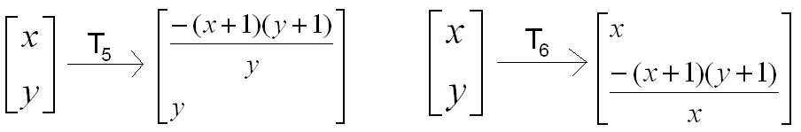

Conjecture: every cycle comes about by treating an involution this way.
Possible counter-example:

Slide 18
(T₆T₅)⁴ = I, but T₅² ≠ I
A cycle is generated,
but not obviously from an involution.
Note: is it possible to break T₅ and T₆ down
into involutions?
Conjecture:
if the period of a cycle is odd,
then it can be written
as a product of involutions.

Slide 19

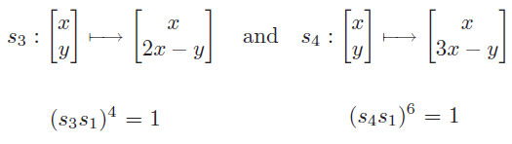
So s₁² = I, s₂² = I, and (s₂s₁)³ = I
Fomin and Reading also suggest alternating
significantly different involutions:
All rank 2 (= dihedral) so far – can we move to rank 3?

Slide 20
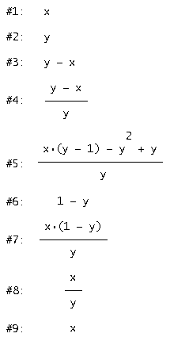
Note:
Alternating
y-x (involution and period 6 cycle) and y/x (involution and period 6 cycle) creates a cycle (period 8).

Slide 21
The functions y/x and y-x fulfil several criteria:
they can each be regarded
as involutions in the F&R sense (period 2)
2) x, y, y/x… and x, y, y-x…
both define periodic recurrence relations (period 6)
3) When applied alternately, as in x, y, y-x, (y-x)/y…
they give periodicity here too (period 8)

Slide 22
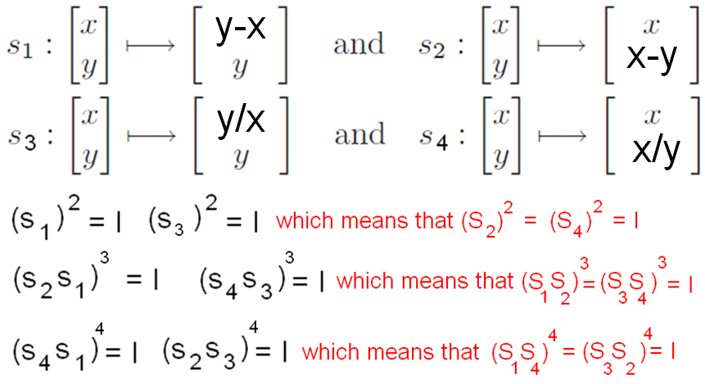

Slide 23
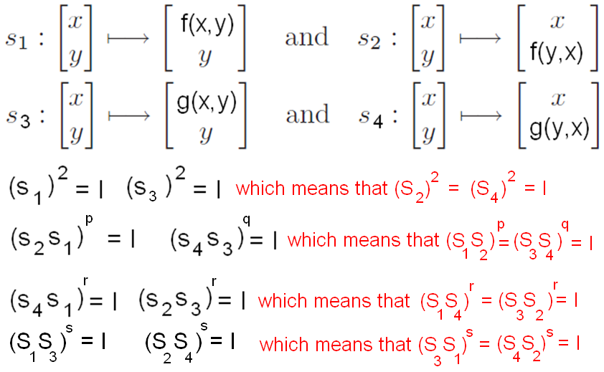
Can f and g combine even more fully? Could we ask for:

Slide 24
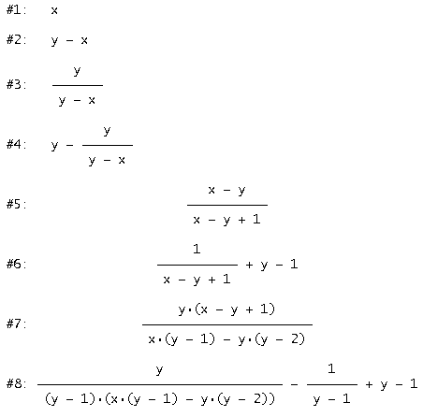
If we regard f and g as involutions in the F&R sense, then if we alternate f and g, is the sequence periodic?
What happens with y – x and y/x?
No joy!

Slide 25
Let
x, y, f(x, y)… is periodic, period 3.
x, y, g(x, y)… is periodic, period 3 also.
h₁(x) = f(x, y) is an involution,
h₂(x) = g(x, y) is an involution.

Slide 26
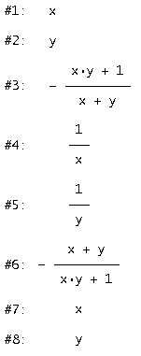
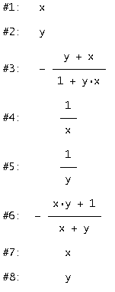
Alternating f and g gives period 6.

Slide 27
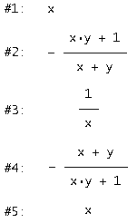
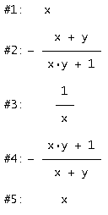
What happens if we alternate h₁ and h₂?
Periodic, period 4.

Slide 28
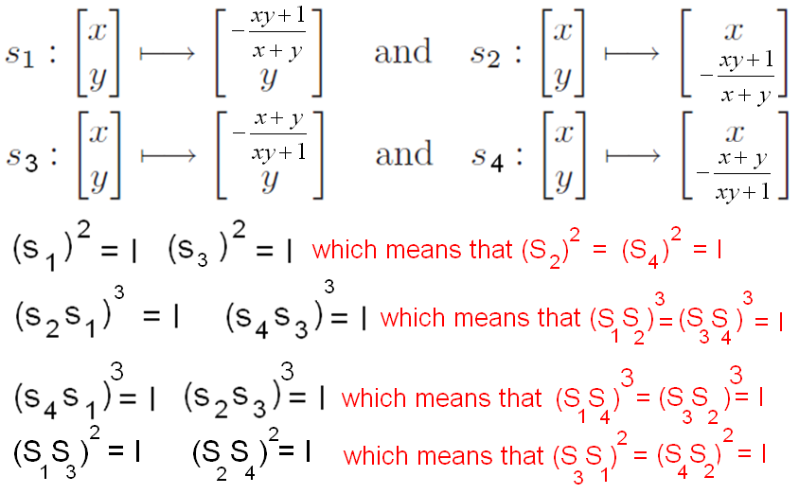

Slide 29
Another such pair is :
Conjecture:
If f(x, y) and g(x, y)
both define periodic recurrence relations
and if f(x, y)g(x, y) = 1 for all x and y,
then f and g will combine in this way.

Slide 30
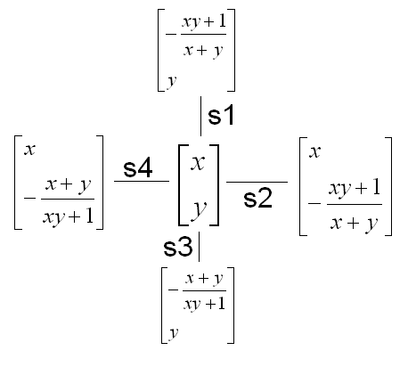

Slide 31

A non-abelian group of 24 elements.
Appears to be rank 4, but…
Which group have we got?

Slide 32
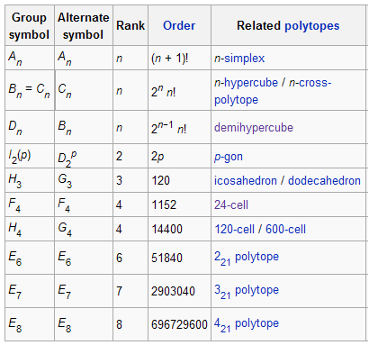

Slide 33
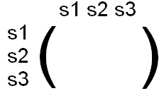

Not all reflection groups can be generated
by PRRs of these types.
(We cannot seem to find a PRR of period greater than six, to start with.)
Which Coxeter groups can be generated by PRRs?
Coxeter groups can be defined by their Coxeter matrices.

Slide 34
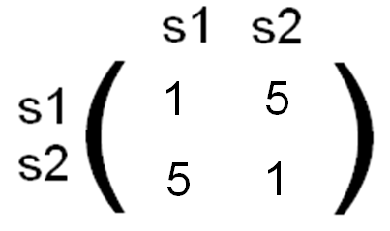
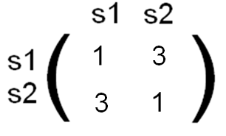
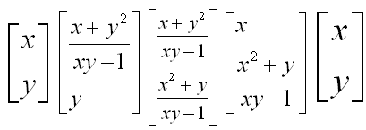
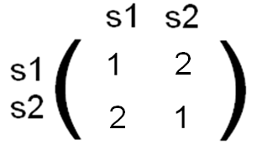

Slide 35

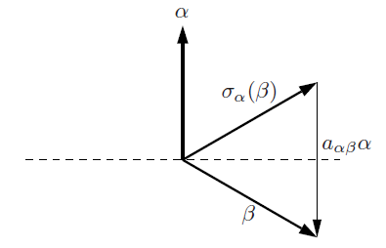
The Crystallographic Restriction

Slide 36
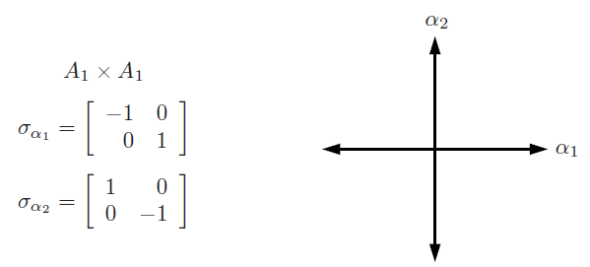
This limits things!
In two dimensions,
only four systems are possible.

Slide 37
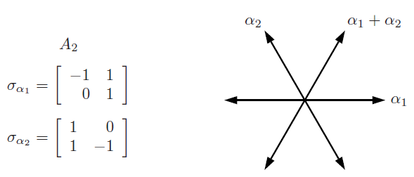

Slide 38
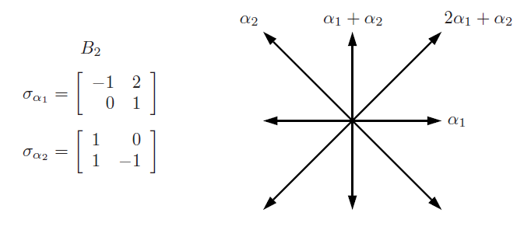

Slide 39
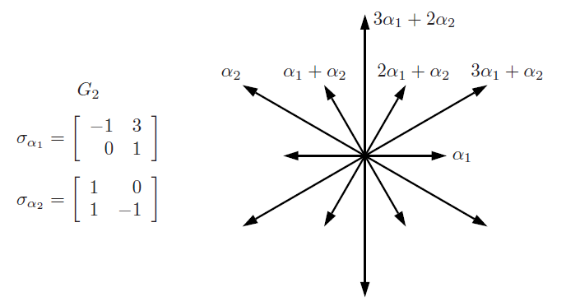
jonny.griffiths@uea.ac.uk

